Slide 1
Mapping the bibliographic call number to the holdings record call number
Yoel Kortick
Senior Librarian

Slide 2

Agenda
Introduction
Setup
The Call Number Mapping table in action

Slide 3
Introduction

Slide 4
Introduction
This presentation will describe how a library may determine which fields and subfields will be copied from the bibliographic record to the 852 field, subfield h and other subfields, in the holdings record.
The following methods use this mapping table:
  Saving a new holdings record in the MD Editor.
  Running the "Update from Bibliographic" menu option on a holdings record from the Record Actions menu in the MD Editor (more on this option in the next three slides)
  Running an import profile job.
  Running the "Change Holding Information" job
See also Call Number Mapping.

Slide 5
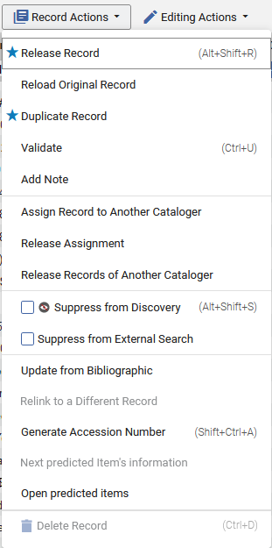
Introduction
In order to use the "Update from Bibliographic" feature, the "Normalize on Save" normalization process for the holdings configuration must be enabled and have the "852 field normalization" task first in the list.

Slide 6
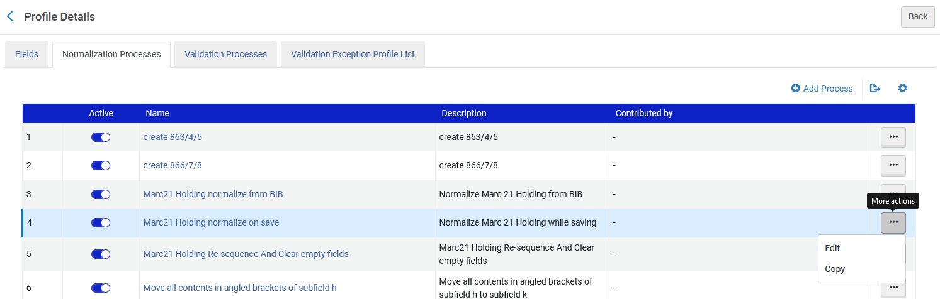
Introduction
Access the "Normalize on Save" normalization process for MARC21 Holdings at "Configuration > Resources > Metadata configuration > MARC21 Holding > Normalization processes

Slide 7
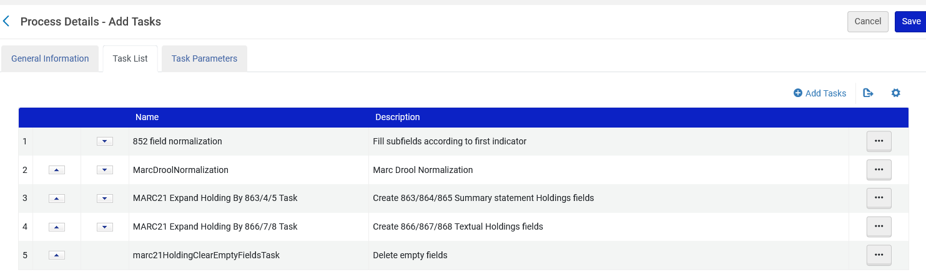
Introduction
The "Normalize on Save" normalization process for the holdings configuration must be enabled and have the "852 field normalization" task first in the list.

Slide 8
Setup

Slide 9
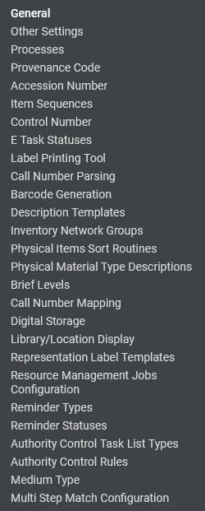
Setup
We will configure the "Call Number Mapping Table"
This table is accessed at "Configuration > Resources > General"

Slide 10
Setup
The purpose of this table is to define which bibliographic fields and related subfields should be copied to the holdings record 852 field, and to which subfields in the 852 holdings record field.
It works according to the 1st indicator of the 852 field in the holdings record

Slide 11
Setup
The 1st indicator of the 852 field in the holdings record is created by one of the following three methods:
  Default holdings record template
  Call number type as defined in the location
  The parameter call_number_type as defined at "Configuration > Resources > General > Other Settings"
A full in-depth discussion about how the 852 holdings record 1st indicator is created is beyond the scope of this presentation.

Slide 12
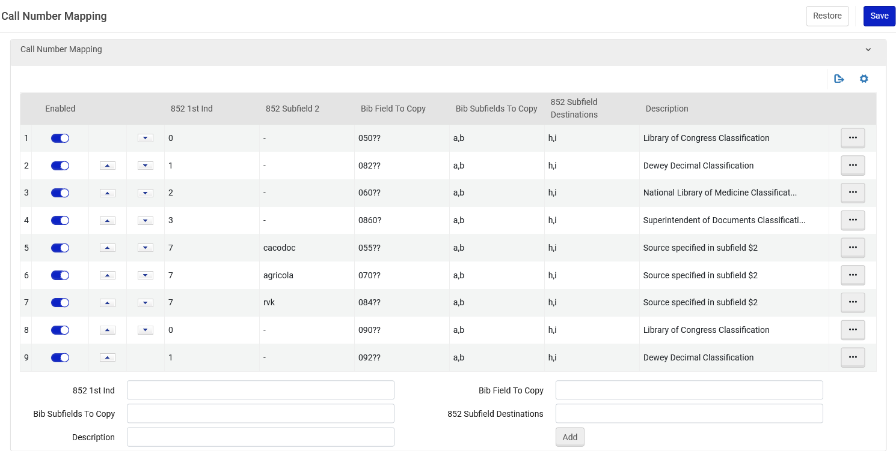
Setup
Here is a sample of the "Call Number Mapping" table

Slide 13
Setup
The following is a description of the columns in the "call number mapping table" (part 1 of 2)
Enabled = Making the line not active is like deleting it, but it can be easily reactivated.
Up and down arrows = determine the order of the lines. The table is read top to bottom. It stops as soon as a match is found.
Bib Field To Copy = The bibliographic field which contains the data which will be copied to the 852 holdings record field.
Bib Subfields To Copy = The subfields of the "Bib Field To Copy " which will be copied to the 852 holdings record field

Slide 14
Setup
The following is a description of the columns in the "call number mapping table" (part 2 of 2)
852 1st Ind = The line will be effective only when the 852 1st indicator equals whatever is in this column
852 Subfield 2 = Only relevant when the "852 1st Ind" is 7. The line will be effective only when the 852 1st indicator equals 7 and the 852 Subfield 2 equals whatever is in this column
852 Subfield Destination= The subfields of the 852 field to which the "Bib Subfields To Copy" will be copied
Description = Free text description of the call number type

Slide 15
Setup
Note that the table is read top to bottom and will act on the first match found.
  For example, in the table shown here both the 050 and the 090 appear with 852 first indicator 0. If the bibliographic record has both a 050 and a 090 then the 050 will be copied to the holdings record because it appears before the 090.
When there is a question mark in the 4th and 5th position of the "Bib Field To Copy" it acts as a wildcard, meaning "any value".

Slide 16
Setup
This line means:
If the 852 of the holdings record has a first indicator 0 then
  Copy the 050 (regardless of indicators) to the holdings record
  Copy the 050 subfield a to 852 subfield h
  Copy the 050 subfield b to 852 subfield i
The logic here is that 050 in the bibliographic record is “Library of Congress Call Number” and first indicator 0 in the 852 of the holdings record is “Library of Congress classification”.

Slide 17
Setup
This line means:
If the 852 of the holdings record has a first indicator 1 then
  Copy the 082 (regardless of indicators) to the holdings record
  Copy the 082 subfield a to 852 subfield h
  Copy the 082 subfield b to 852 subfield i
The logic here is that 082 in the bibliographic record is “Dewey Decimal Classification Number” and first indicator 1 in the 852 of the holdings record is “Dewey Decimal classification”.

Slide 18
Setup
This line means:
If the 852 of the holdings record has a first indicator 2 then
  Copy the 060 (regardless of indicators) to the holdings record
  Copy the 060 subfield a to 852 subfield h
  Copy the 060 subfield b to 852 subfield i
The logic here is that 060 in the bibliographic record is “National Library of Medicine Call Number” and first indicator 2 in the 852 of the holdings record is “National Library of Medicine classification”.

Slide 19
Setup
This line means:
If the 852 of the holdings record has a first indicator 3 then
  Copy the 086 (if it has first indicator 0 and any second indicator) to the holdings record
  Copy the 086 subfield a to 852 subfield h
  Copy the 086 subfield b to 852 subfield i
The logic here is that 086 in the bibliographic record is “Government Document Classification Number” and first indicator 3 in the 852 of the holdings record is “Superintendent of Documents classification”.

Slide 20
Setup
This line means:
If the 852 of the holdings record has a first indicator 7 and subfield 2 with value "cacadoc" then
  Copy the 055 (regardless of indicators) to the holdings record
  Copy the 055 subfield a to 852 subfield h
  Copy the 055 subfield b to 852 subfield i
The logic here is that 055 in the bibliographic record is “Classification Numbers Assigned in Canada” and subfield 2 “cacodoc” in the 852 of the holdings record is “Canadian Commissioner of Documents (CACODOCS) classification”.

Slide 21
Setup
This line means:
If the 852 of the holdings record has a first indicator 7 and subfield 2 with value "agricola" then
  Copy the 070 (regardless of indicators) to the holdings record
  Copy the 070 subfield a to 852 subfield h
  Copy the 070 subfield b to 852 subfield i
The logic here is that 070 in the bibliographic record is “National Agricultural Library Call Number” and subfield 2 “agricola” in the 852 of the holdings record is “AGRICOLA (AGRICultural OnLine Access) - a database produced by the National Agricultural Library (NAL)”.

Slide 22
Setup
This line means:
If the 852 of the holdings record has a first indicator 7 and subfield 2 with value "rvk" then
  Copy the 084 (regardless of indicators) to the holdings record
  Copy the 084 subfield a to 852 subfield h
  Copy the 084 subfield b to 852 subfield i
The logic here is that 084 in the bibliographic record is “Other Classification Number” and subfield 2 “rvk” in the 852 of the holdings record is “Regensburger Verbundklassifikation (RVK, Regensburg Union Classification)”.

Slide 23
Setup
This line means:
If the 852 of the holdings record has a first indicator 0 then
  Copy the 090 (regardless of indicators) to the holdings record
  Copy the 090 subfield a to 852 subfield h
  Copy the 090 subfield b to 852 subfield i
The logic here is that 090 in the bibliographic record is “Library of Congress Call Number” and first indicator 0 in the 852 of the holdings record is “Library of Congress classification”.

Slide 24
Setup
This line means:
If the 852 of the holdings record has a first indicator 1 then
  Copy the 092 (regardless of indicators) to the holdings record
  Copy the 092 subfield a to 852 subfield h
  Copy the 092 subfield b to 852 subfield i
The logic here is that 092 in the bibliographic record is “Local Dewey Decimal Classification Number” and first indicator 1 in the 852 of the holdings record is “Dewey Decimal classification”.

Slide 25
The Call Number Mapping table in action

Slide 26
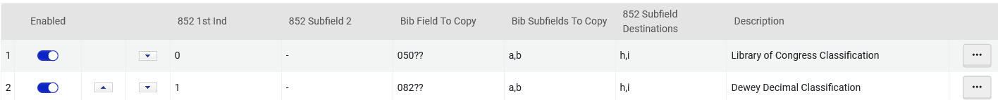
The Call Number Mapping table in action
We will now see how this line works

Slide 27
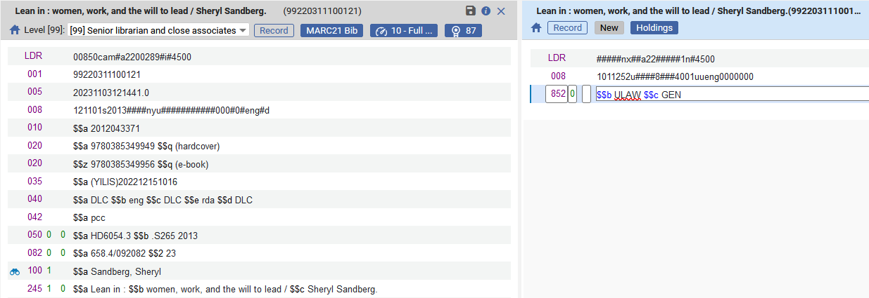
The Call Number Mapping table in action
The bibliographic record has both a 050 and a 082.
The holdings record has an 852 with first indicator 0.
The 852 currently has only subfields b and c

Slide 28
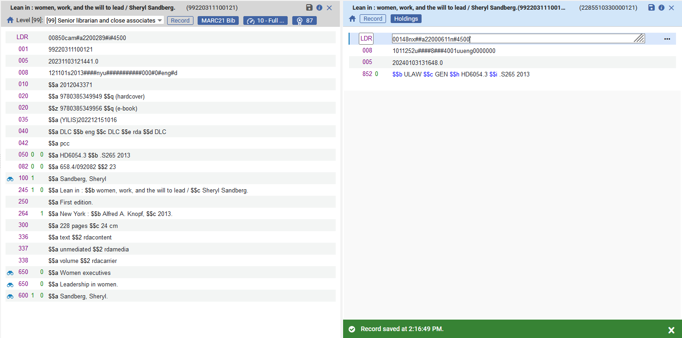
The Call Number Mapping table in action
After saving
The 050 a from the bibliographic record got copied to the 852 h of the holdings record
The 050 b from the bibliographic record got copied to the 852 i of the holdings record

Slide 29
The Call Number Mapping table in action
We will now see how this line works

Slide 30
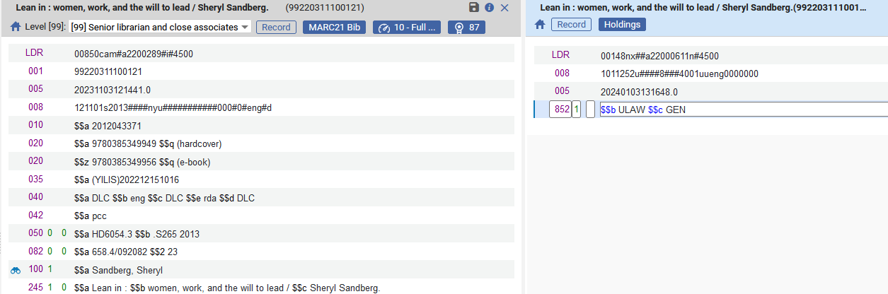
The Call Number Mapping table in action
The bibliographic record has both a 050 and a 082.
The holdings record has an 852 with first indicator 1.
The 852 currently has only subfields b and c

Slide 31
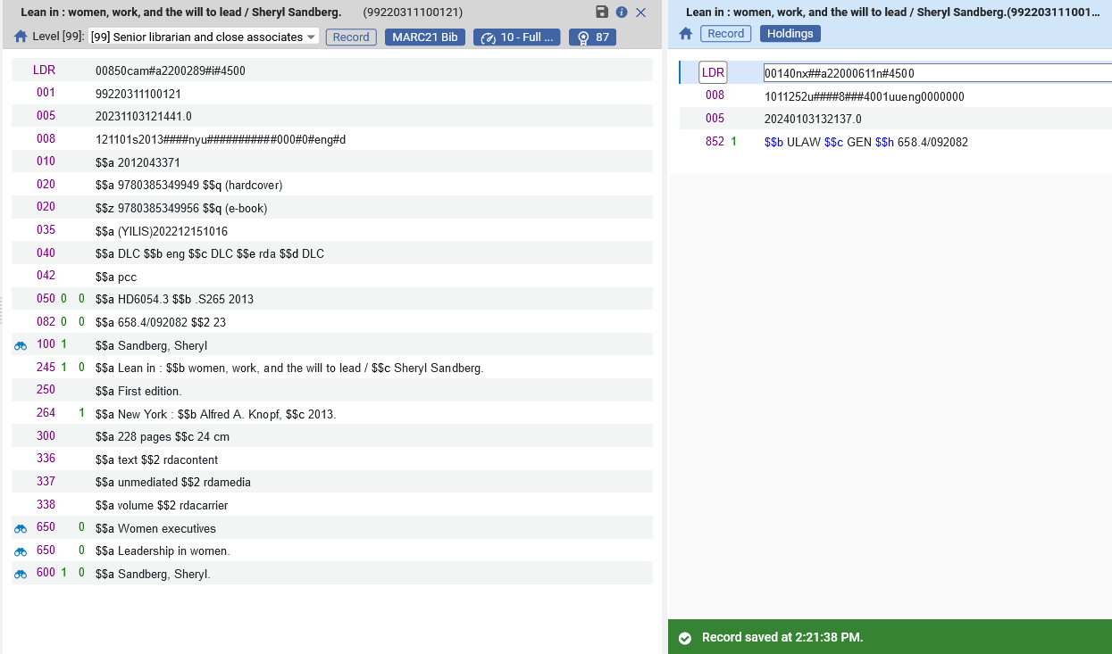
The Call Number Mapping table in action
After saving
The 082 a from the bibliographic record got copied to the 852 h of the holdings record

Slide 32
The Call Number Mapping table in action
We will now see how this line works

Slide 33
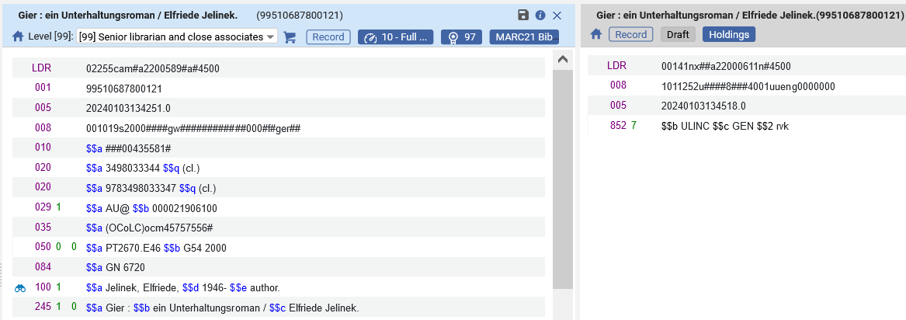
The Call Number Mapping table in action
The bibliographic record has a both a 050 and 084
The holdings record has an 852 with first indicator 7 and subfield 2 rvk.
The 852 currently has only subfields b, c and 2.

Slide 34
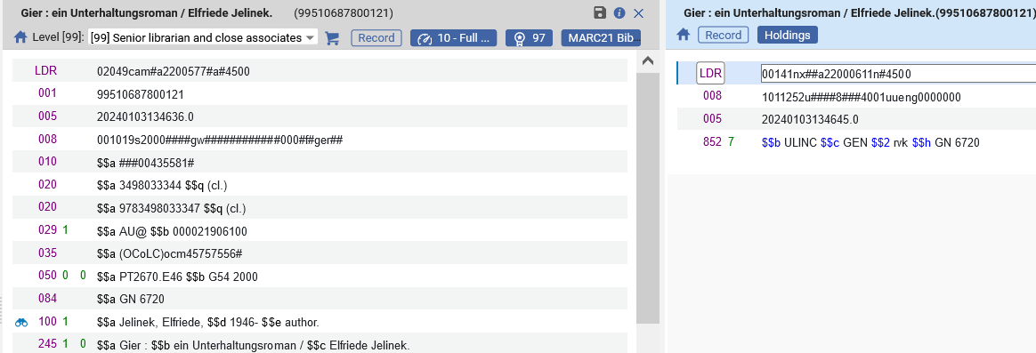
The Call Number Mapping table in action
After saving
The 084 a from the bibliographic record got copied to the 852 h of the holdings record

